Slide 1
Fly Phi Figures
Angus Leung 2018-05-30
(Legends in notes sections)

Slide 2
Abstract
The integrated information theory of consciousness (IIT) proposes integrated information (Φ) as a potential multivariate measure of level of consciousness, but its most up-to-date and theoretically attractive version, Φ^{3.0}, is difficult to apply to biological networks. Here, we developed a method to apply Φ^{3.0} in wakeful and anesthetised flies, and compared the results of Φ^{3.0} to the uni- and bi-variate measures power and coherence, and Φ*, a derivation which is easier to apply to neural recordings. Isoflurane anesthesia reduced both Φ^{3.0} and Φ*, and the reduction in Φ^{3.0} resulted in greater classification accuracy of awake and anesthesia conditions than low frequency power, coherence and Φ*. We further found Φ^{3.0} magnitudes of networks to be related to the Φ^{3.0} generated by its parts. These results push Φ^{3.0} as a measure of conscious level and has implications in making its applications to large sets of recordings easier.

Slide 3
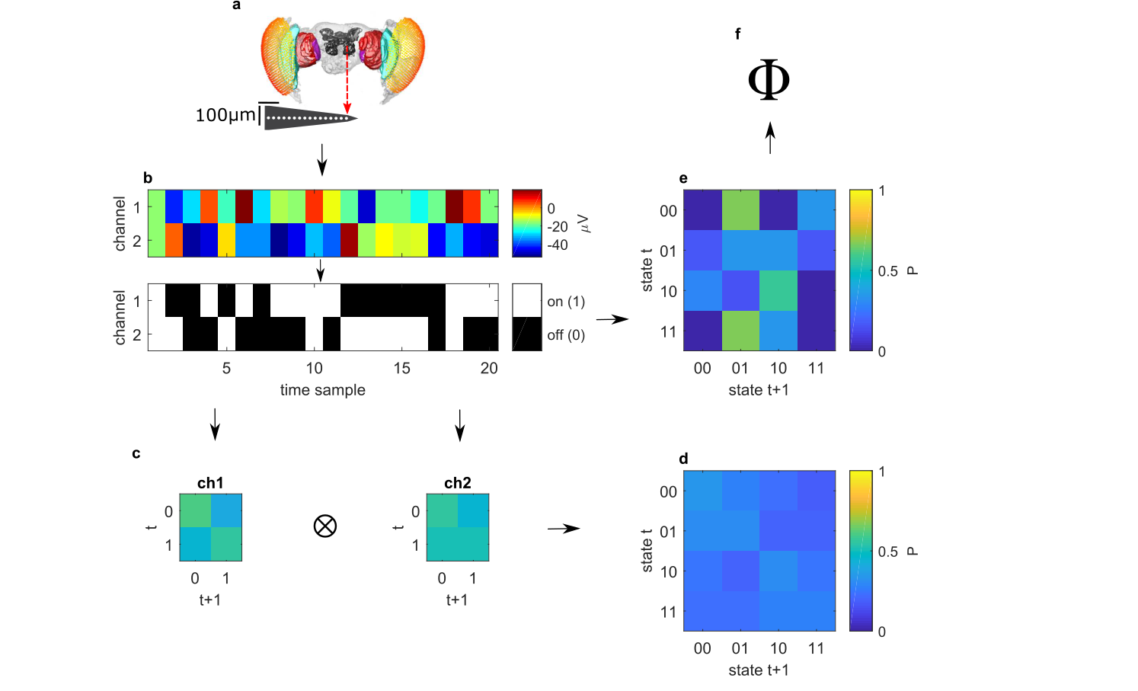
Notes:
Figure 1. Processing pipeline for computing Φ^{3.0}. (a) A linear multi-electrode probe records LFPs from the fly brain. (b) Samples in each channel are discretised into one of two values. Displayed is an example of 20 samples for a network of two channels. The network state at a given sample is given by the states of its channels – either on (above the median of the LFP for that channel) or off (equal to or below the median). (c) TPMs can be calculated for a split network, e.g. for each channel (ch1 for channel 1, ch2 for channel 2). Each cell in the TPM gives the probability of a state transitioning to another state. Here, TPMs are created with τ=1 sample. (d) Multiplying transition probabilities between parts of the network gives transition probabilities of the full reducible network. (e) The transition probabilities of the full network. (f) d and e are compared using a distance metric (see main text) to calculate Φ^{3.0}.

Slide 4
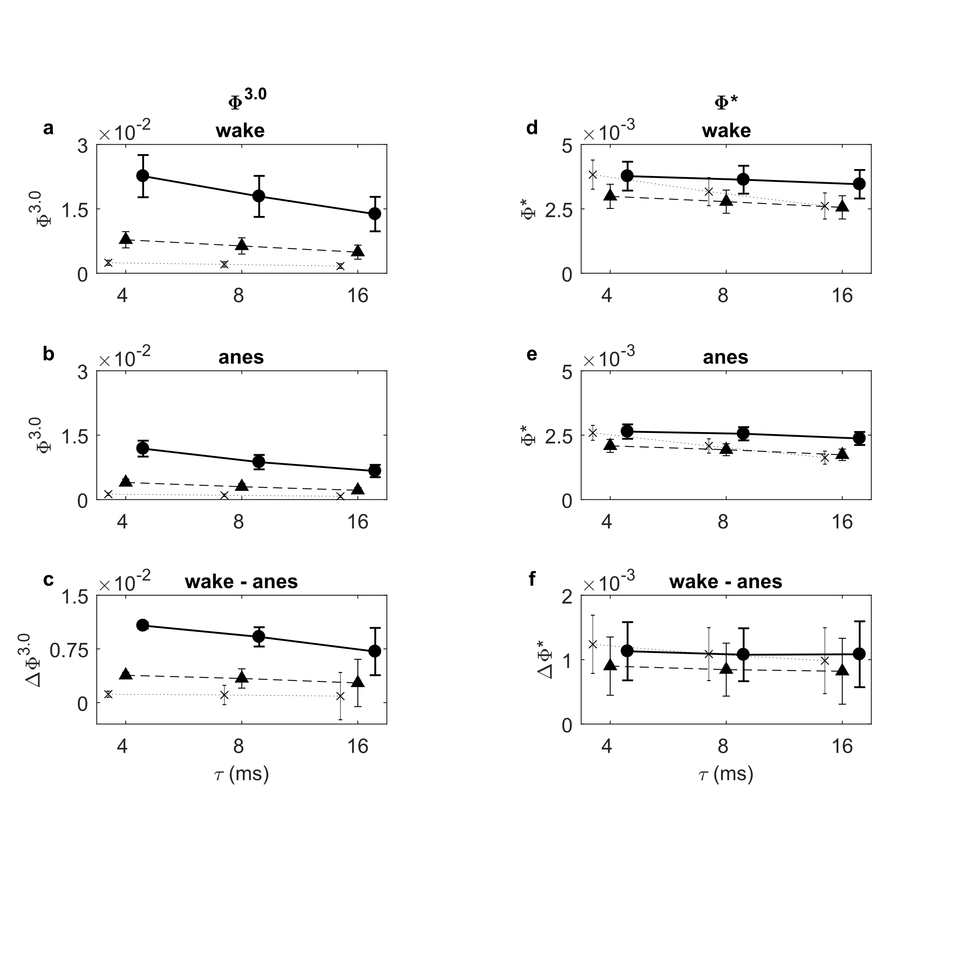
Notes:
Figure 2. Average Φ^{3.0} and Φ* in the fly brain at each condition, lag, and network size, across all networks and flies. x with dotted line = 2 channels; triangle with dashed line = 3 channels; circle with solid line = 4 channels. (a) Φ^{3.0} values in the awake condition. (b) Φ^{3.0} values during the anesthesia condition. (c) Change in Φ^{3.0} between conditions (wake – anesthesia). (d-f) Same as (a-c), but for Φ*. Error bars represent standard error of the mean across N=13 flies for all panels.
NOTE:
NOTE: This is currently showing phi-3 values for 18s TPM and phi-* values for 2.25s covariance. It will be updated to show phi-3 values for 2.25s TPMs (currently waiting for computations at tau=8ms and 16ms)
NOTE:

Slide 5
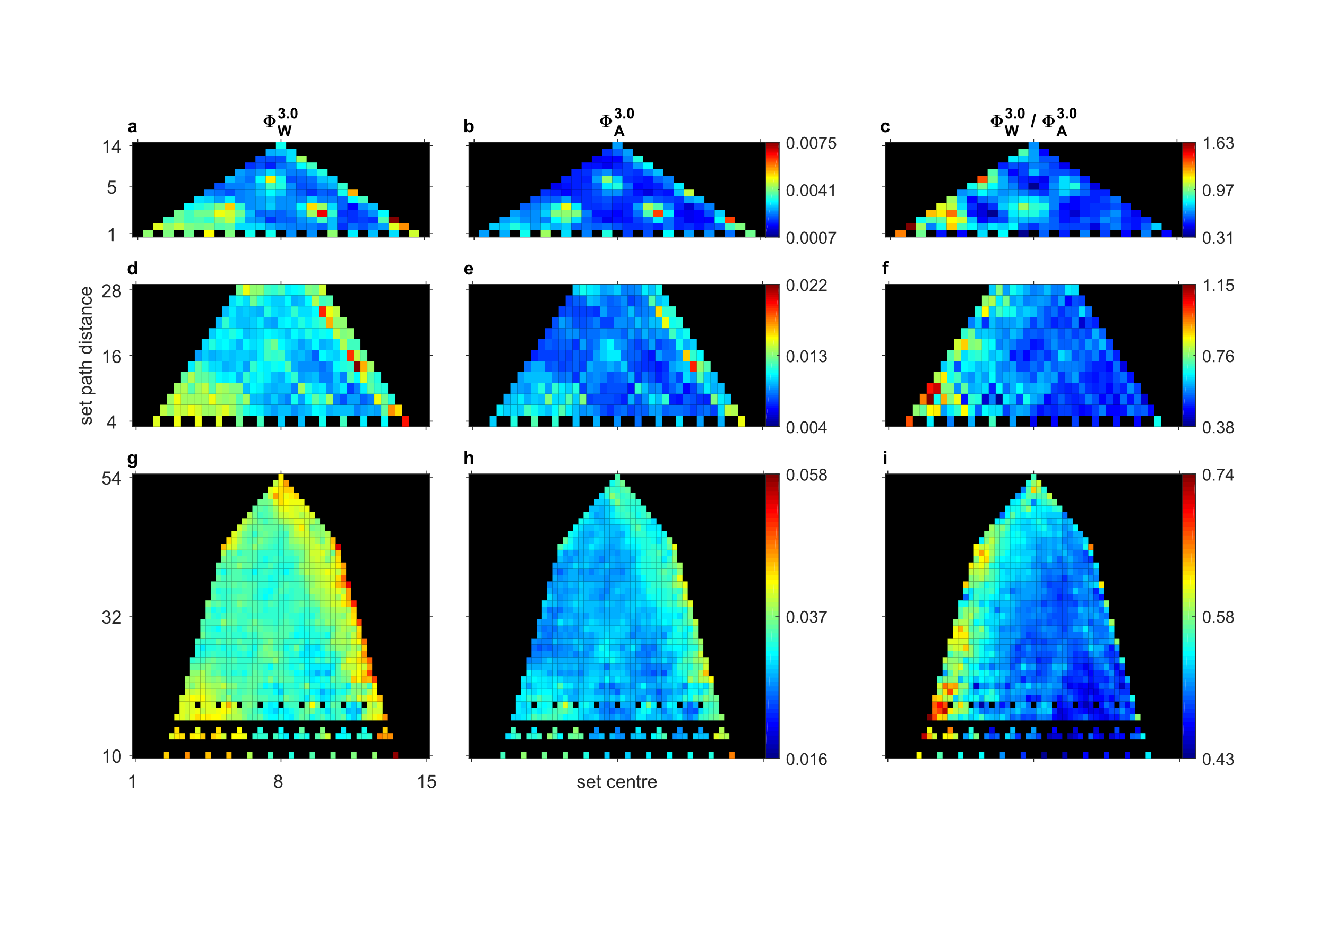
Notes:
Figure 3. Average Φ^{3.0} values (τ=4ms) as a function of distance among channels and channel set centre, including interpolated values (see main text). (a) Average 2 channel Φ^{3.0} values during the awake condition. (b) Average 2 channel Φ^{3.0} values during the anesthesia condition. (c) Average relative change in 2 channel Φ^{3.0} between conditions (wake / anesthesia). (d-f) Same as (a-c) but for 3 channel Φ^{3.0}. (g-i) Same as (a-c) but for 4 channel Φ^{3.0}.

Slide 6
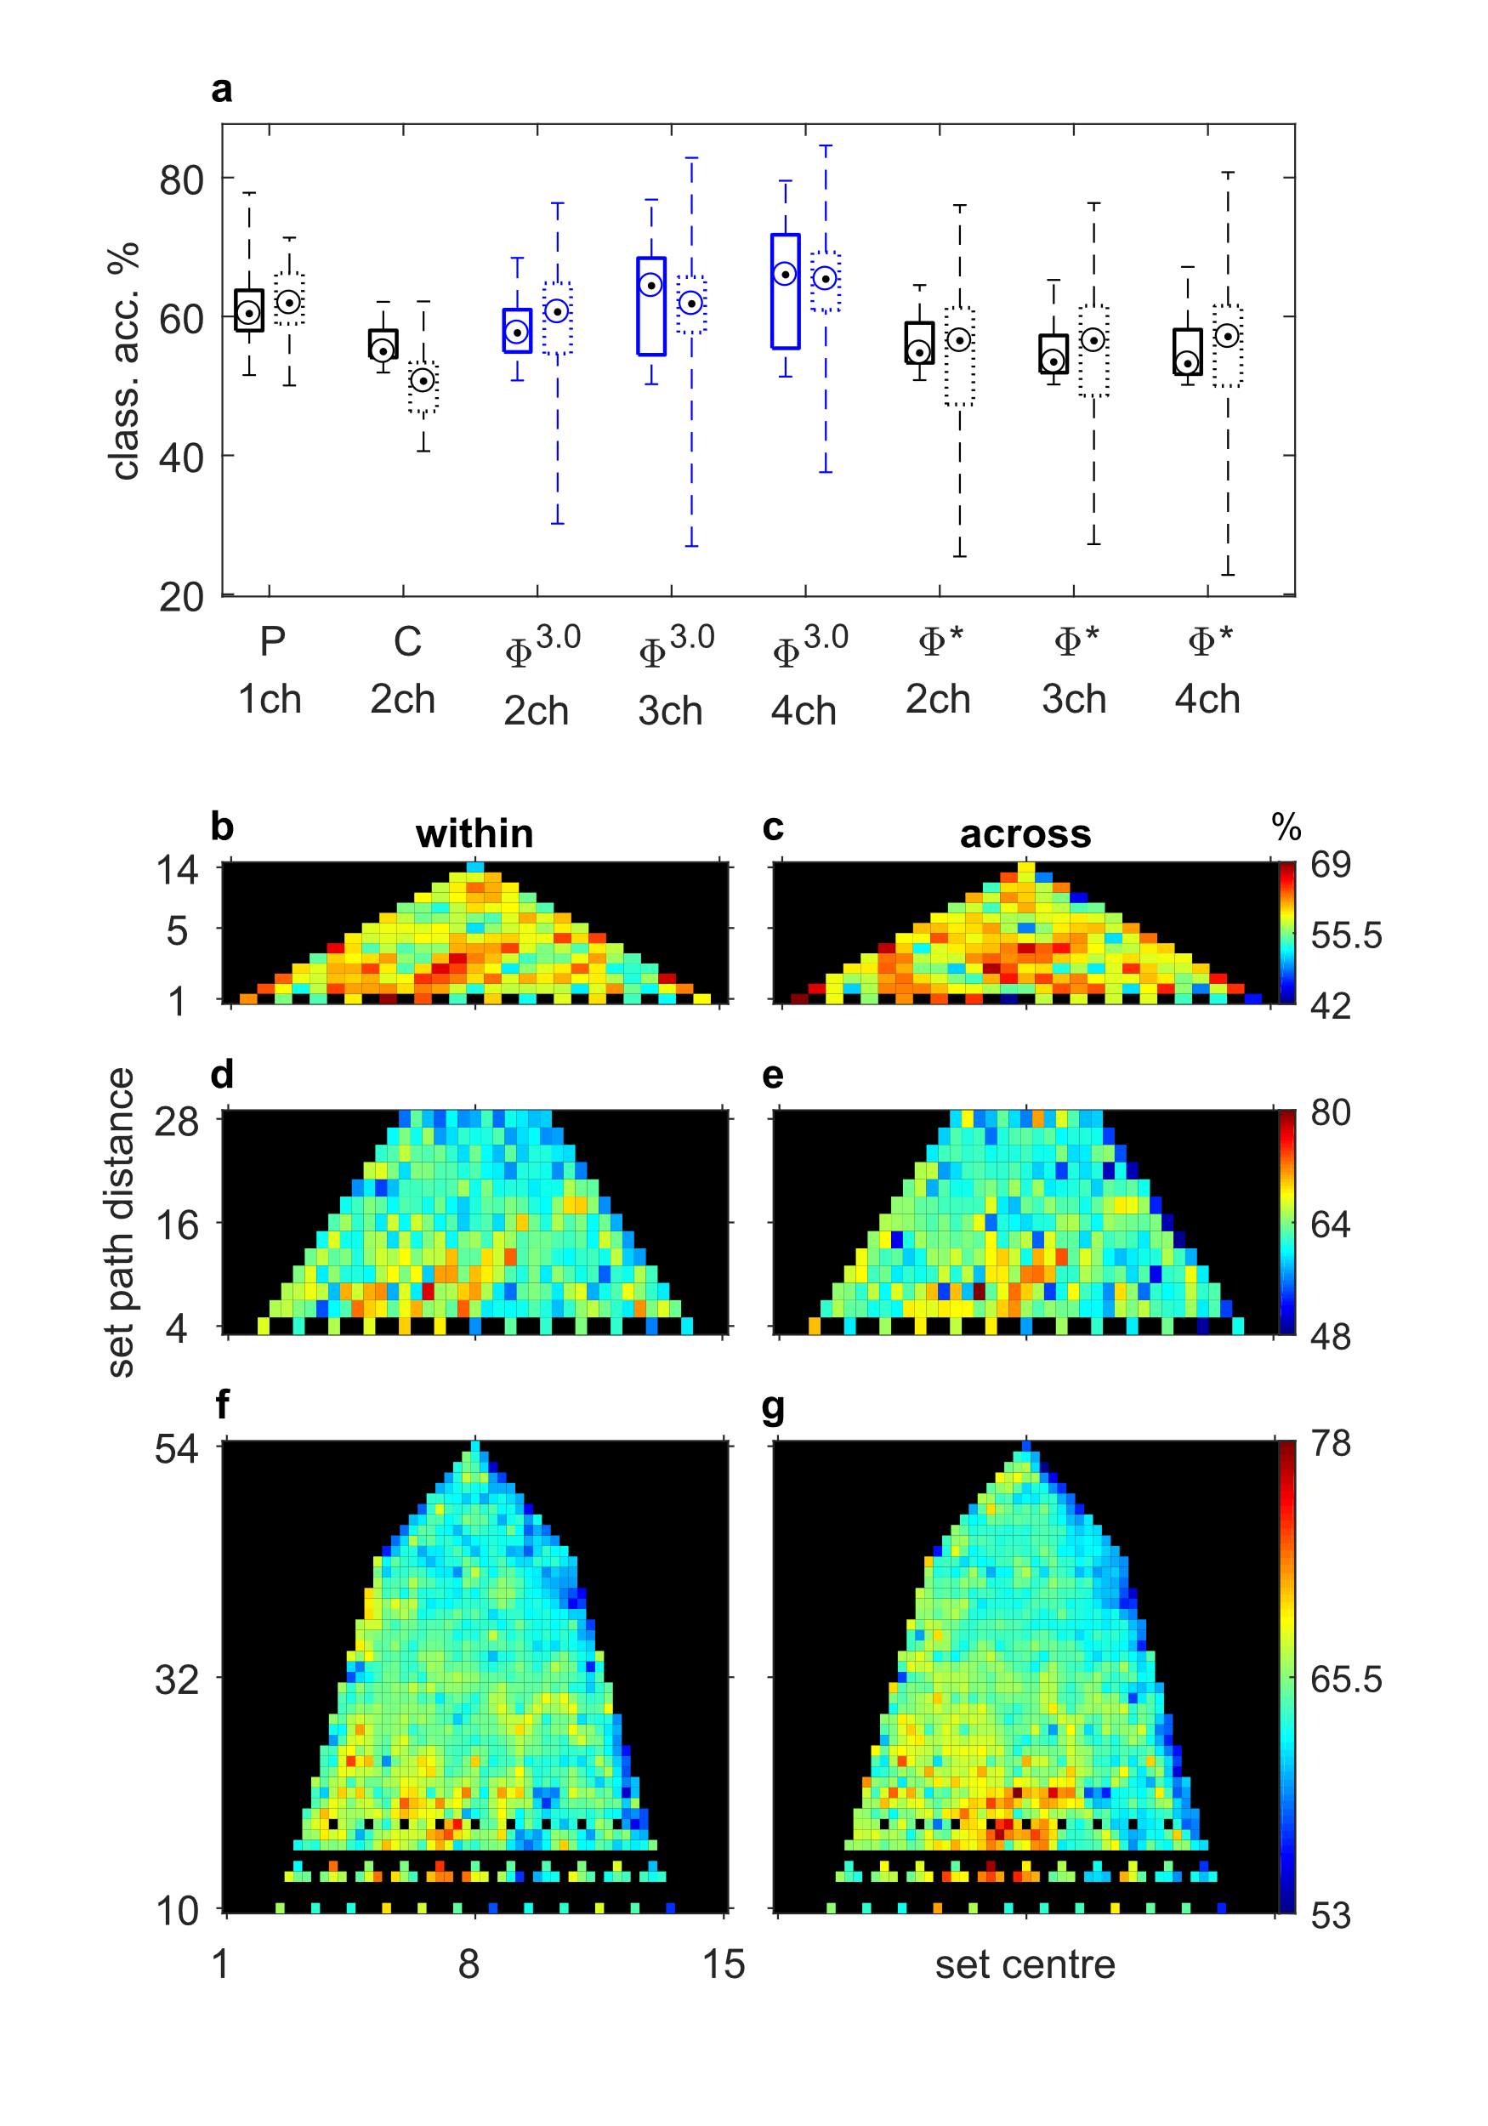
Notes:
Figure 4. Leave-one-out awake/anesthesia classification performance of Φ^{3.0} (τ=4ms). (a) Within (solid boxes) and across (dotted boxes) fly leave-one-out classification of condition (awake/anesthesia) using mean 0-5Hz power, mean 0-5Hz coherence, Φ^{3.0}, and Φ*. Targets denote median classification accuracy, across sets (for within fly classification) or across flies (for across fly classification). Boxes denote 25th and 75th percentiles, and whiskers denote minimum and maximum accuracies. (b) 2 channel Φ^{3.0} classification performance for each channel set (across 8x2 trials) as a function of distance among channels and channel set centre, including interpolated values. Averaged across N=13 flies. (c) 2 channel Φ^{3.0} classification performance for each channel set (across 13 flies). (d, e) Same as (b, c) but for 3 channel Φ^{3.0}. (f, g) Same as (b, c) but for 4 channel Φ^{3.0}.

Slide 7
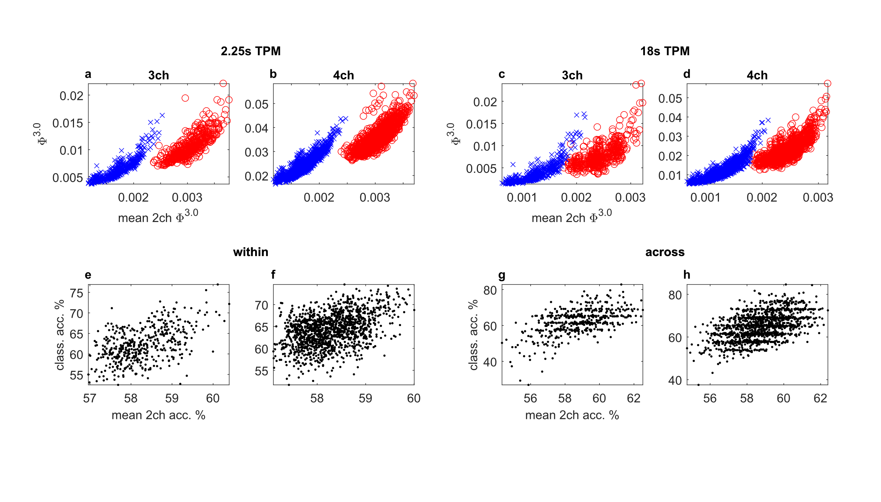
Notes:
Figure 5. n-channel Φ^{3.0} values (τ=4ms) and classification performance as a function of single channel values and performance (see main text). (a, b) Average 3 channel Φ^{3.0} (a) and 4 channel Φ^{3.0} (b) values as a function of single channel Φ^{3.0} values computed using 2.25s TPM. Blue x’s denote anesthesia values; red circles denote awake values. (c, d), Same as (a, b) but for values computed using an 18s TPM. (e, f) Average 3 channel Φ^{3.0} (e) and 4 channel Φ^{3.0} (f) within fly classification performance (classification across 8x2 trials) as a function of single channel classification performance. (g, h) Same as (e, f), but for across fly classification.

Slide 8
Supplementary figure plan
S1 – phi-star version of figure 3
S2 – power/coherence classification (within/across flies) as function of frequency
S3 – coherence classification using same set-distance/set-centre mapping (as in figure 4b,c).
S4 – phi-star version of figure 4
S5 – phi-star version of figure 5

